Slide 1
Prepared by : Tanupriya Awasthi as on 01/03/2025
HOTEL BOOKINGS

Slide 2
Agenda
Problem Statement
Data Description
Key Metrics and Visualizations
Conclusion

Slide 3
Problem statement
Our task is to analyze hotel booking data to identify key trends, patterns, and insights that can help hotel management make data-driven decisions. The project involves conducting an Exploratory Data Analysis (EDA) on a dataset of hotel bookings, which includes detailed information such as booking dates, arrival dates, length of stay, customer details, special requests, and more. The analysis will be performed using Python, utilizing libraries like Pandas, Seaborn, and Matplotlib for data manipulation and visualization.

Slide 4
Methodology
Firstly we have extracted the data and loaded it in pandas.
Then we looked the data and its data types where we found some incorrect data types so correct them in order to visualize them properly.
After that we checked for duplicates and drop them.
Then we checked for the missing values and found missing values
in about four columns.
Then we checked for outliers and filled those missing values accordingly. If outliers were found then filled them with median else with mean. Filled the categorical values with the mode.
Then we analyzed the data with the help of various functions like mean, groupby, lambda and various graphs like bar and line graph.

Slide 5
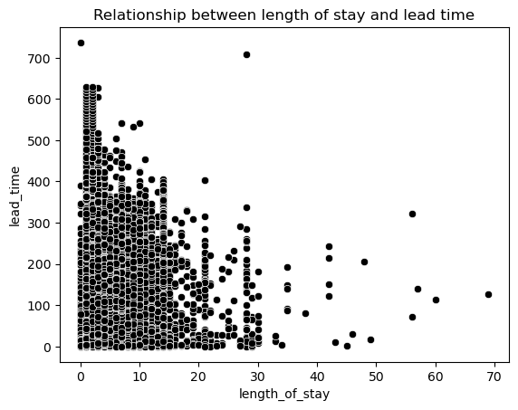
Relation between lead time and length of stay
With the chart it is clearly visible
that there is no strong relation
between the two variables as the
points are widely scattered and do
not form any upward or downward
trend.

Slide 6
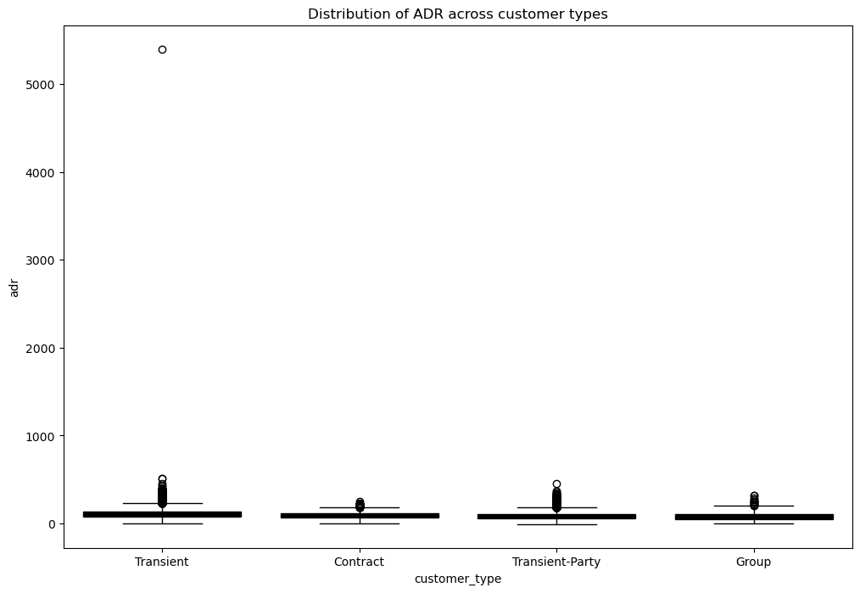
Distribution of ADR across different Customer Types
In the chart we can see that there are outliers
in each and every customer type.
Transient : Most transient ADR
values cluster around certain range but
there are some booking that are highly-priced.
Transient party: Few outliers can be seen
suggesting that typical rates for these
customers may be moderately high but there
are occasional bookings that skew higher.
Contract and Group: As compared to other
customers these customers appear tightly
clustered with lower median and fewer outliers
that suggest these customers tend to have
more standardized ADRs which shows
consistency.

Slide 7
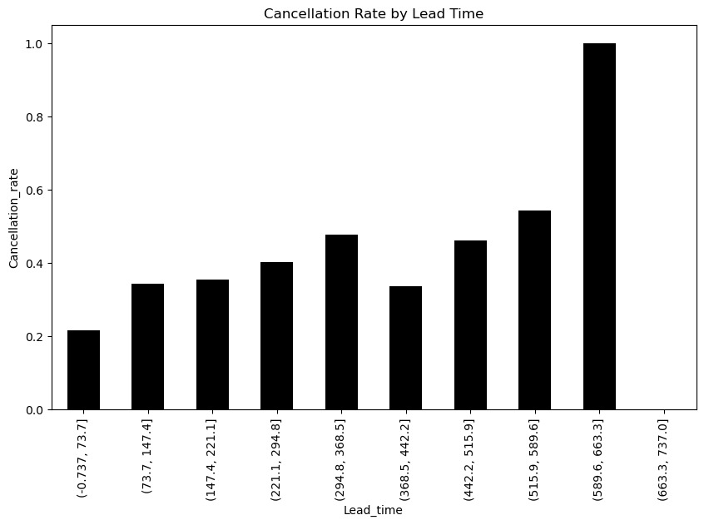
Cancellation rate by lead time
We can see that as the lead time increases the rate of cancellation is increasing which means that advance booking likely have a higher chances of cancellation as the plans of the people may change over the time. So we can say that last minute booking are more ‘committed’.
In the final bin there is extremely high cancelation rate which can mean there might be few bookings only in that range. We can check bin size especially for the final bin to get a more clear view.

Slide 8
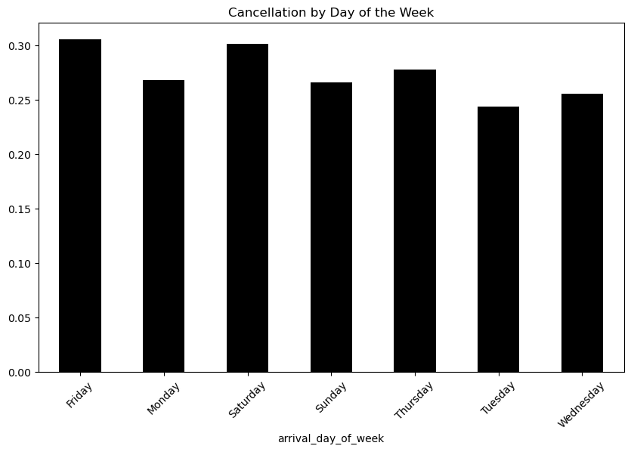
Cancellation by day of week
On Friday and Saturday relatively higher cancellation rate can be seen which shows that weekends arrivals are more prone to cancellation.
In midweek Tuesday and Wednesday we see relatively lesser cancellations that shows more stable travel plans.

Slide 9
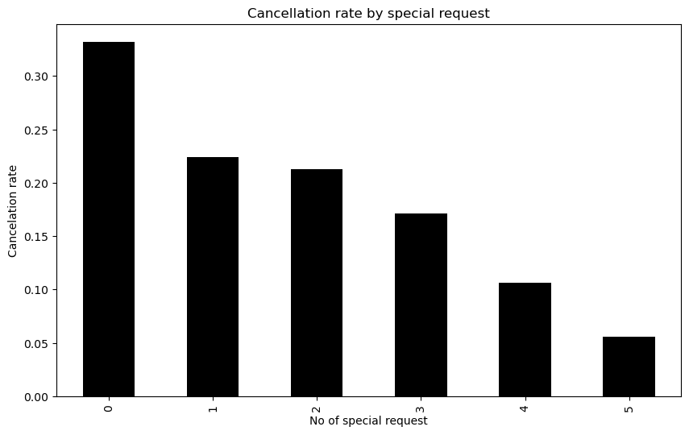
Cancellation rate by special request
We see that as the number of special request increases the cancelation rate decreases showing the indirect relationship between the variables.
Thus the guest who made more special request tend to be more committed to their bookings and cancel less frequently. Also special request indicate specific travel needs or higher level of planning ,hence lesser chances of cancellation

Slide 10
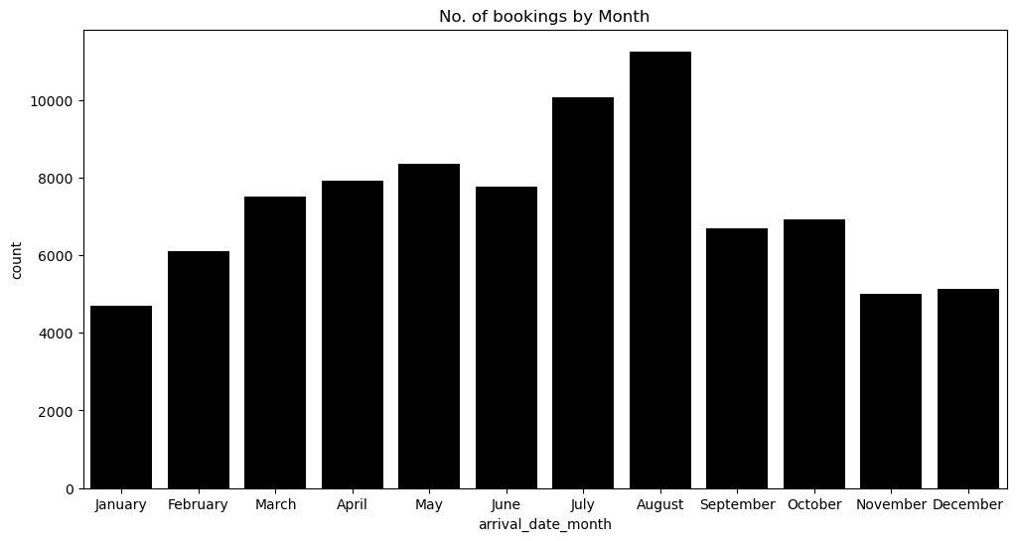
Number of bookings by month
Here we see that till the month of July there was continuous increase in the number of bookings however we see a slight decrease in the bookings in June.
We see that in the month of August there was the highest number of bookings followed by July.

Slide 11
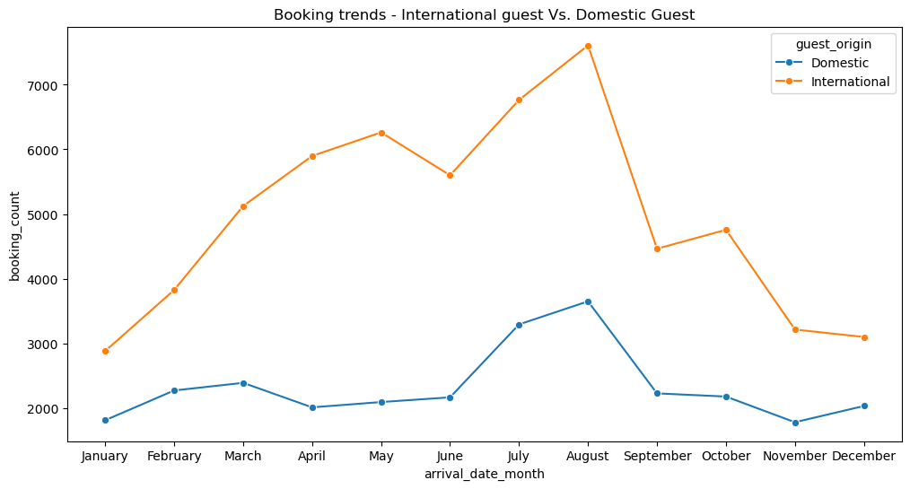
Booking trends
International guests have significantly higher booking counts than domestic guests.
In the month of August there was highest number of international bookings followed by a sharp decrease in September.

Slide 12
Conclusion
On the basis of the visualization we require non-refundable deposits or we should have stricter cancellation policies in order to reduce the booking cancelations.
We should offer discounts for non-cancelable bookings.
We have seen that international guest are less likely to cancel and they tend to stay longer than the domestic guest therefore we can promote longer stay offers to international guests.
We can see that the guest with special request are less likely to cancel therefore we should upsell personalized services.
We can also offer early booking discounts for advance reservations.
We can also increase the rates for last minute bookings
To improve the guest retention we can offer discounts for future stays.

Slide 13
References
Data: From Newton School
Tools used: Python and its libraries like Pandas, Seaborn, Matplotlib etc.
Software used: Juypter Notebook

Slide 14
Thank You

